Slide 1
A GEOSPATIAL APPROACH TO ASSESSMENT, IMPLEMENTATION AND MONITORING OF LAND DEGRADATION NEUTRALITY IN NIGERIA
Dr. Matthew Adepoju
Director, Strategic Space Applications Department
National Space Research and Development Agency
Obasanjo Space Centre
Umaru Musa Yar’adua Express Way, P.M.B. 437, Lugbe, Abuja. Nigeria. matthew.adepoju@nasrda.gov.ng

Slide 2
Outline
Introduction/Background
Statement of the problem
Objectives
Methodology/Implementation Plan/Activities
Final/Preliminary Results/Outputs
Conclusion/Expected outcomes
Expected/Proposed Application Areas
Stakeholders and Users

Slide 3
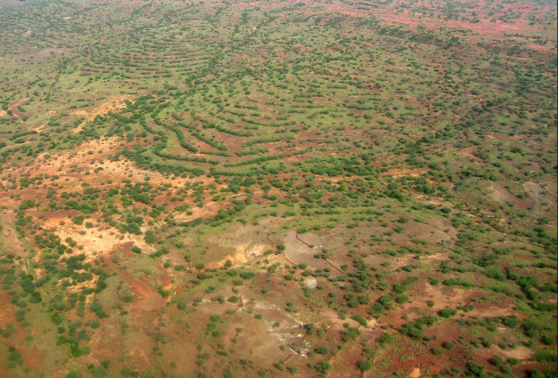
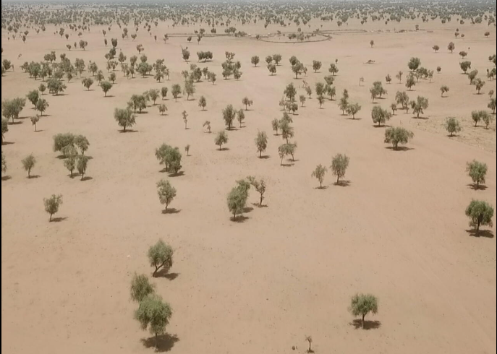
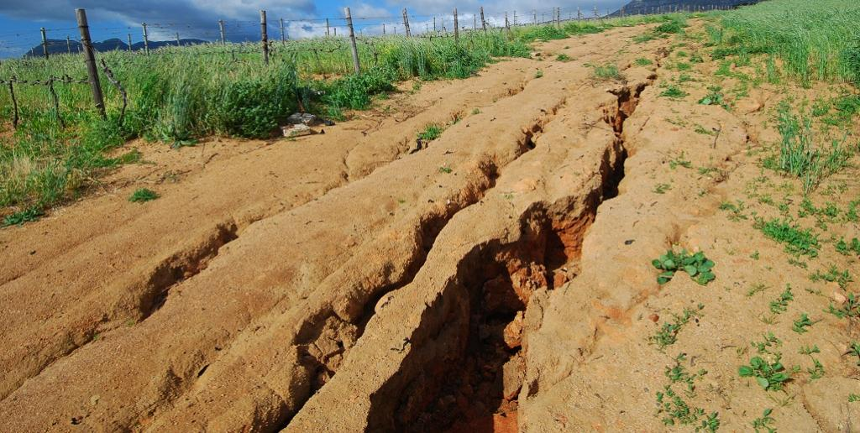
Introduction/Background
Land degradation is the consistent loss of ecosystem functionality due to human and natural processes. It affects biodiversity and ecosystem services, exacerbates climate change, and ultimately impacts the well-being and livelihoods of 1.5 billion people globally.
Neutrality implies no net loss of the land-based natural capital relative to a reference state, or baseline. The aim of land degradation neutrality (LDN) is to maintain or enhance land-based natural capital and its associated ecosystem services and hinged on three indicators
Source: Getty Images
Source: Getty Images
Source: Getty Images

Slide 4
Introduction/Background
These set of indicators are proposed by the LDN framework for countries to inform on the proportion of land that is degraded over total land area (SDG Indicator 15.3.1) and guide effort towards the United Nations Convention to Combat Desertification (UNCCD) objectives.
These three indicators are: Trends in land cover
Trends in land productivity
Trends in carbon stocks above and below ground

Slide 5
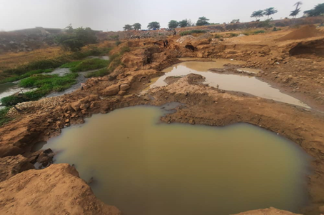
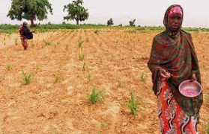
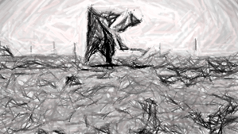
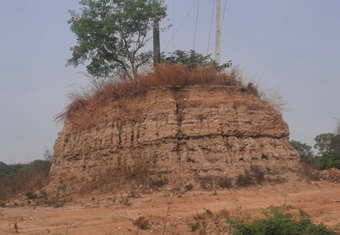
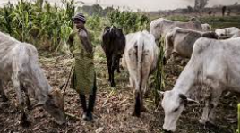
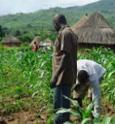
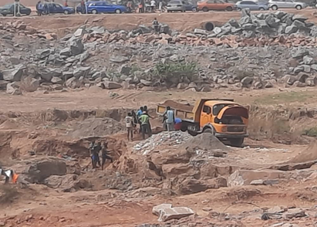
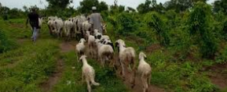
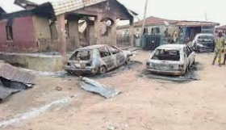
Statement of Problem
Land Degradation has led to serious environmental and attendant associated problems
Soil Erosion and Flooding due to sand mining
Desertification, Loss of Arable Land, Low Agricultural production and Food Insecurity
Source: Getty Images
Eroded surface from incessant floods in North central Nigeria

Slide 6
Objectives
A comparative geospatial assessment of land cover trends; land productivity, land productivity state decline and land productivity trajectory trends, soil organic carbon stock assessment and Land Degradation Neutrality Status.
The comparative assessment considered the status quo pre and post 2015 (adoption of the SDG 15 in 2015).
This study presents the results of a geospatial cloud-based approach to assess monitor and implement Land Degradation Neutrality using indicators and expert opinion.

Slide 7
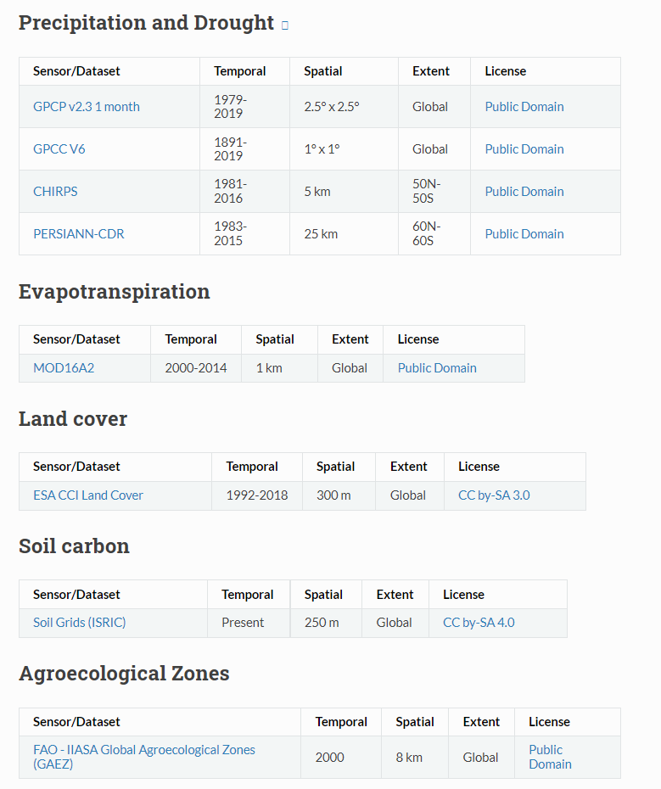
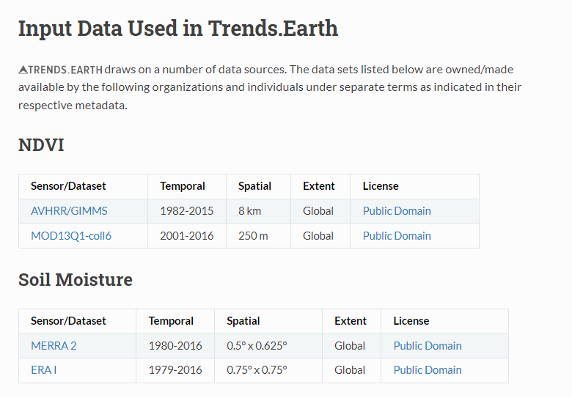
DATA AND SOURCES AS INPUTS IN TRENDS.EARTH

Slide 8
Methodology (Data & Methods)

Slide 9
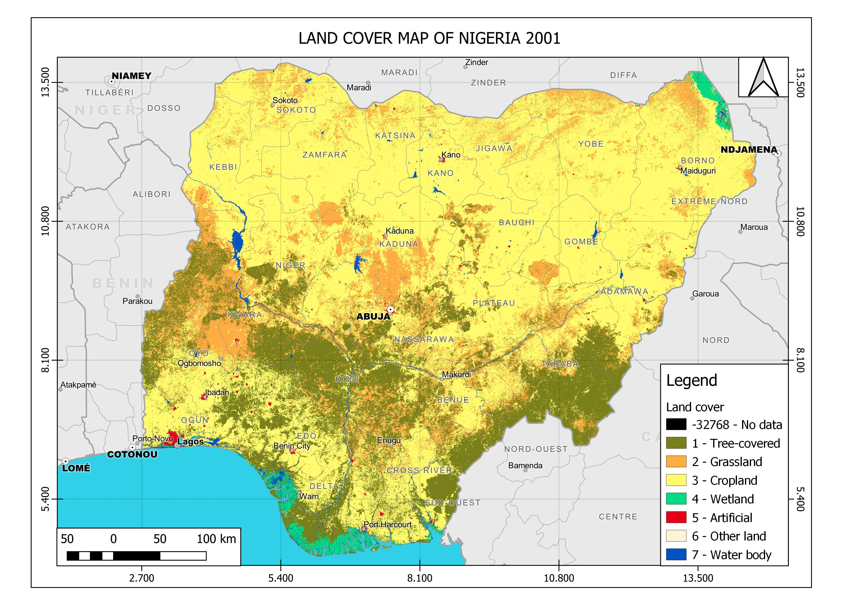
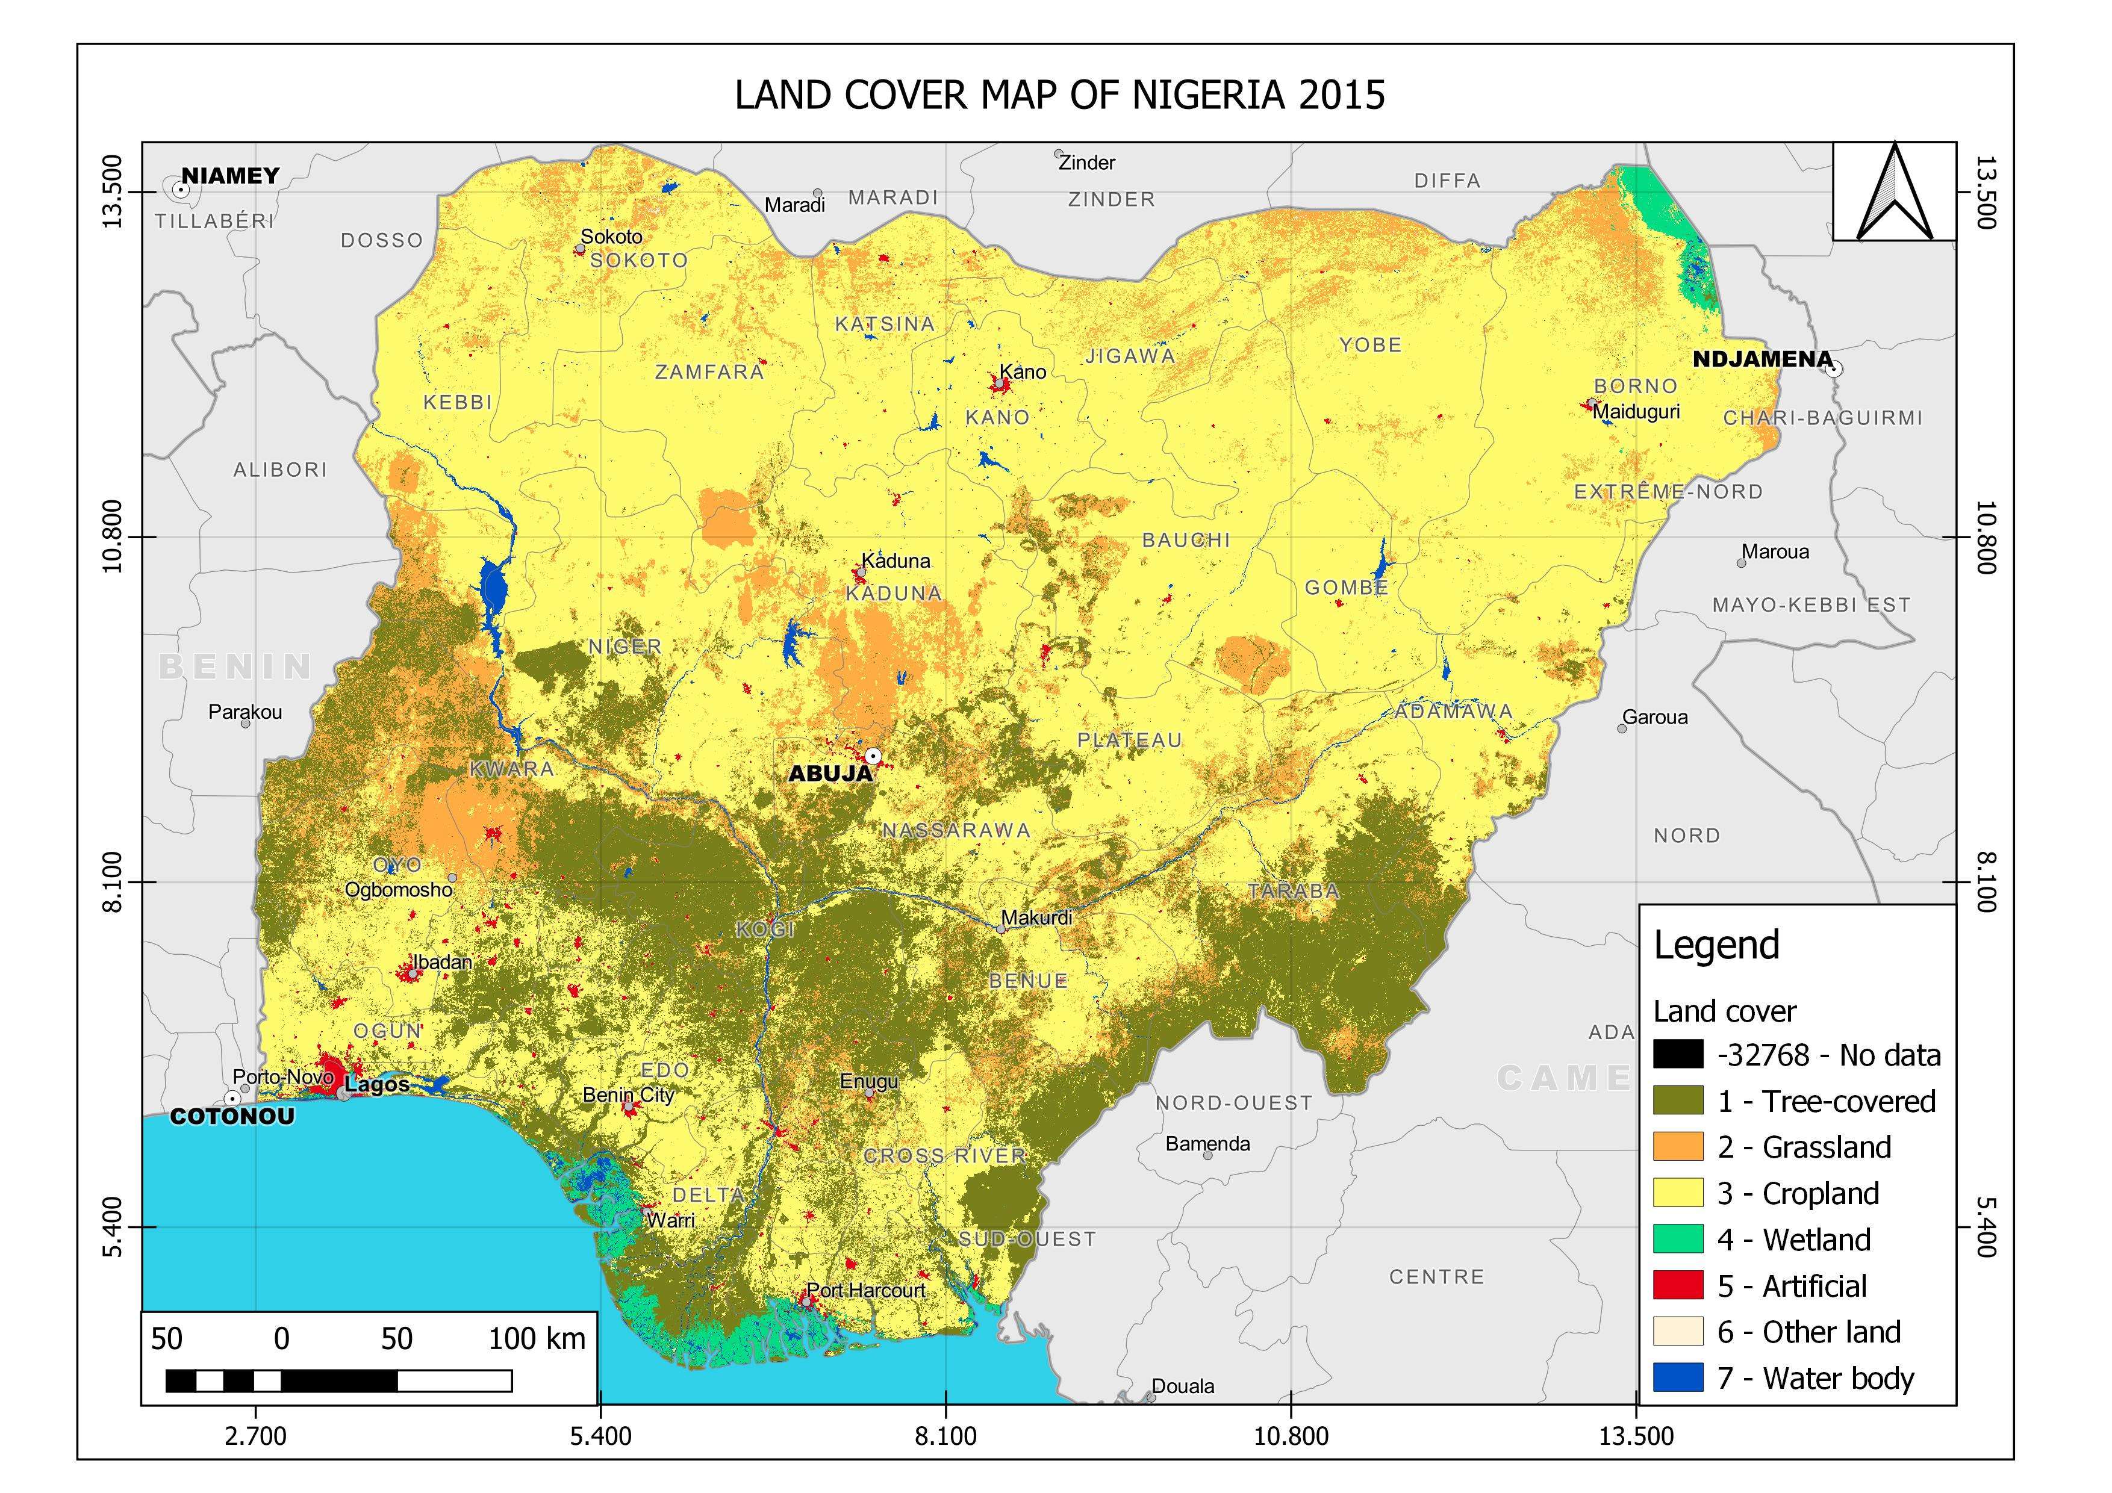
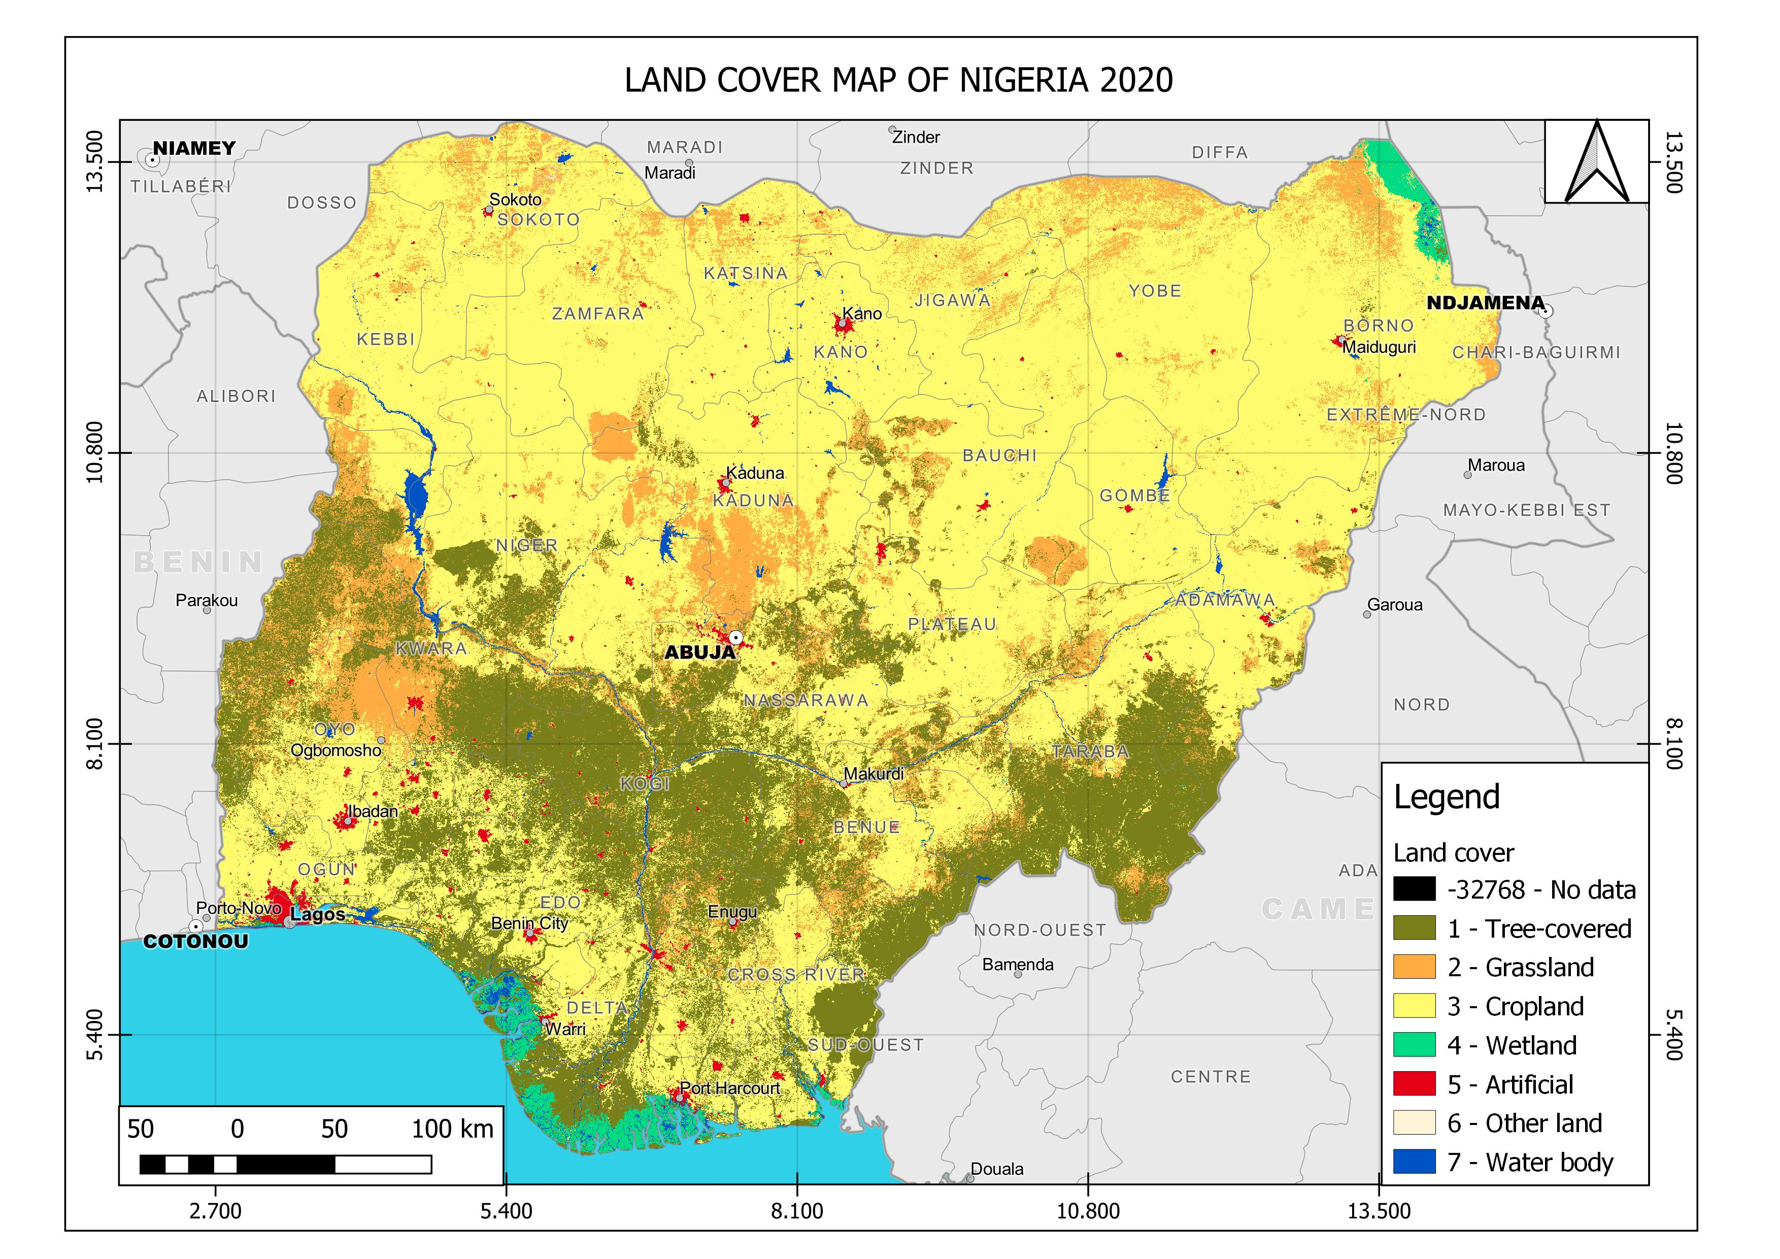
Final Results; Land Cover Trends
 | Baseline area (sq. km) | Target area (sq. km) | Change in area (sq. km) | Change in area (percent)
Tree-covered areas | 175,495.30 | 182,786.79 | 7,291.49 | 4.15%
Grasslands | 147,290.57 | 116,384.83 | -30,905.74 | -20.98%
Croplands | 560,442.43 | 580,859.32 | 20,416.90 | 3.64%
Wetlands | 11,857.09 | 11,760.24 | -96.85 | -0.82%
Artificial areas | 3,046.93 | 6,191.25 | 3,144.32 | 103.20%
Other lands | 138.06 | 154.98 | 16.92 | 12.26%
Water bodies | 9,233.37 | 9,366.33 | 132.96 | 1.44%
 | Baseline area (sq. km) | Target area (sq. km) | Change in area (sq. km) | Change in area (percent)
Tree-covered areas | 182,767.05 | 194,208.57 | 11,441.52 | 6.26%
Grasslands | 116,349.82 | 109,133.13 | -7,216.69 | -6.20%
Croplands | 580,701.46 | 574,207.37 | -6,494.09 | -1.12%
Wetlands | 11,757.60 | 11,705.82 | -51.78 | -0.44%
Artificial areas | 6,406.59 | 8,497.66 | 2,091.07 | 32.64%
Other lands | 154.98 | 191.05 | 36.06 | 23.27%
Water bodies | 9,364.98 | 9,558.87 | 193.90 | 2.07%

Slide 10
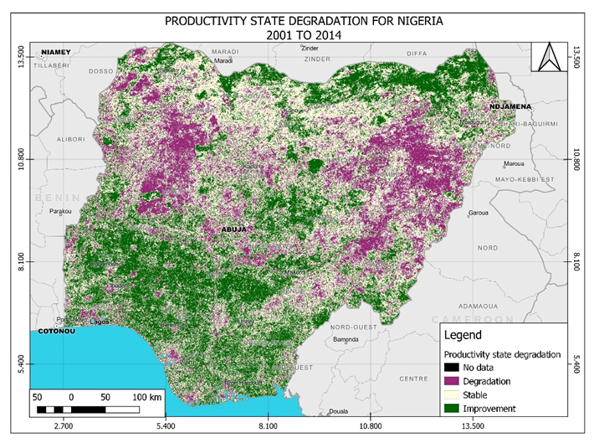
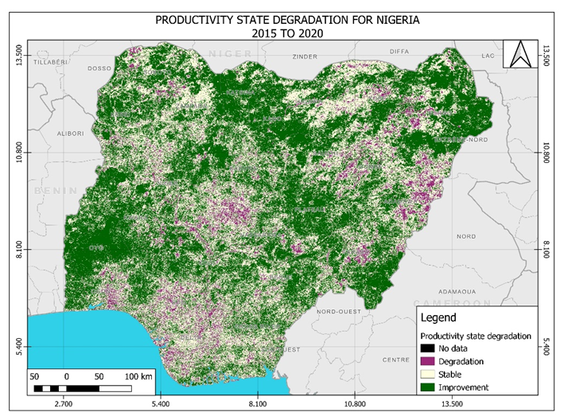
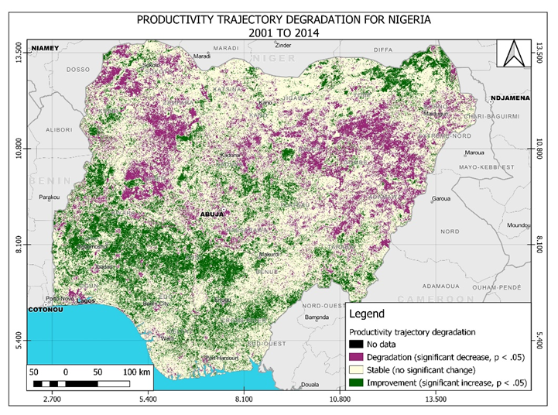
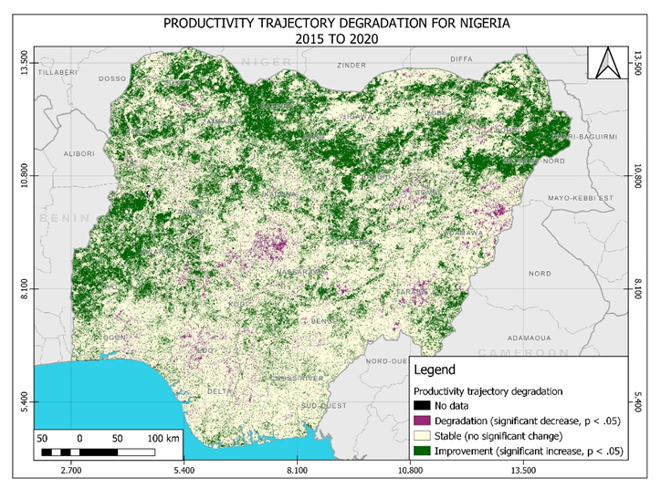
Final Results; Productivity Degradation State and Trajectory

Slide 11
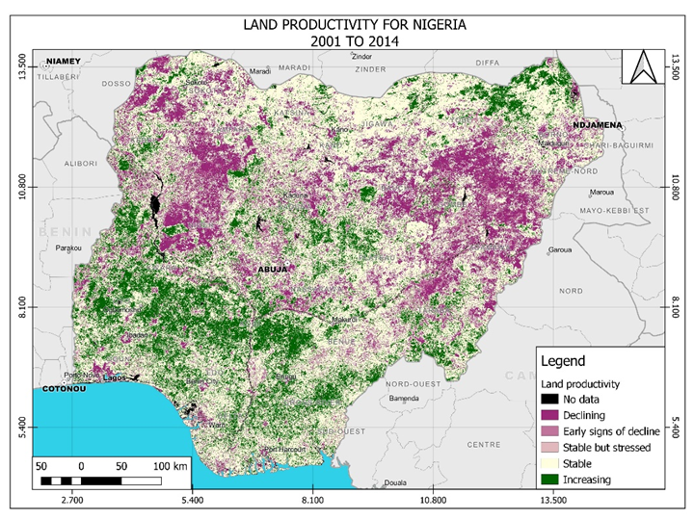
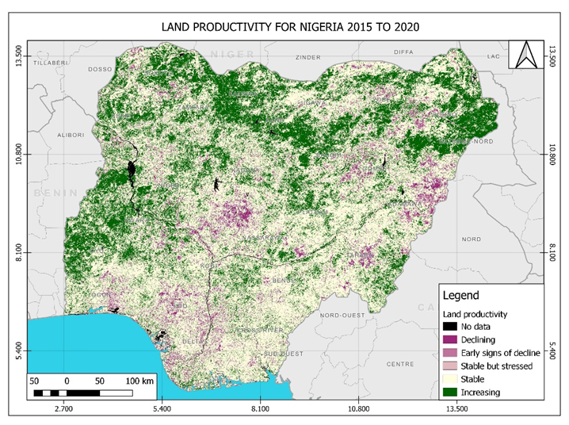
Final Results; Land Productivity

Slide 12
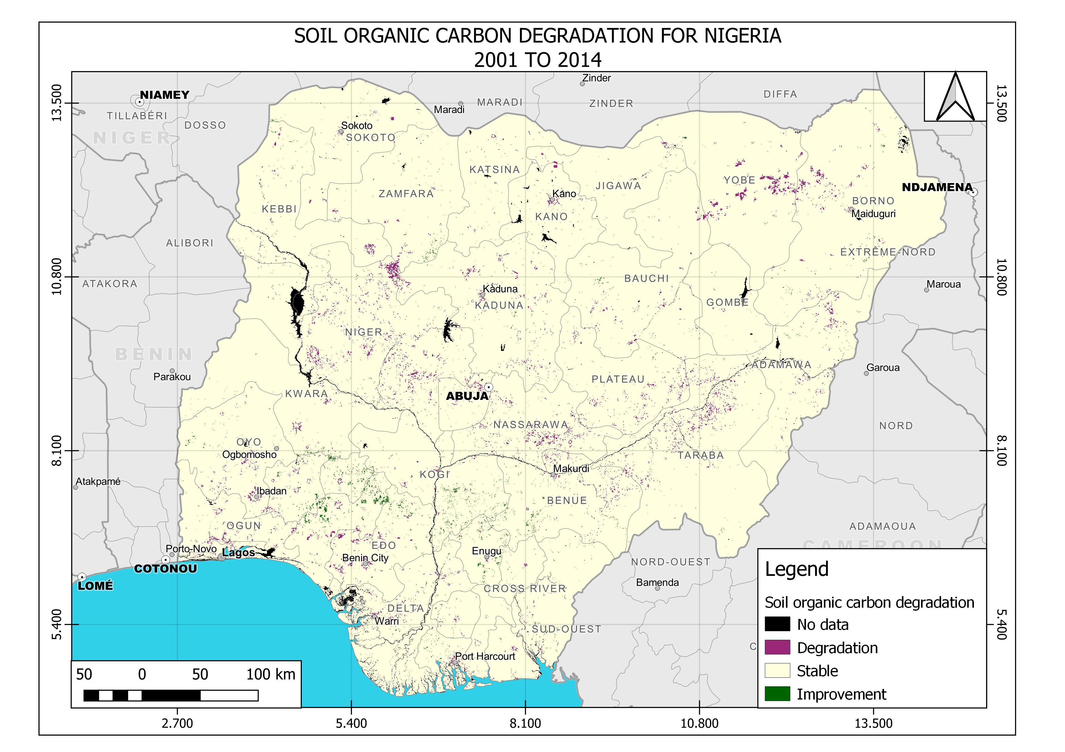
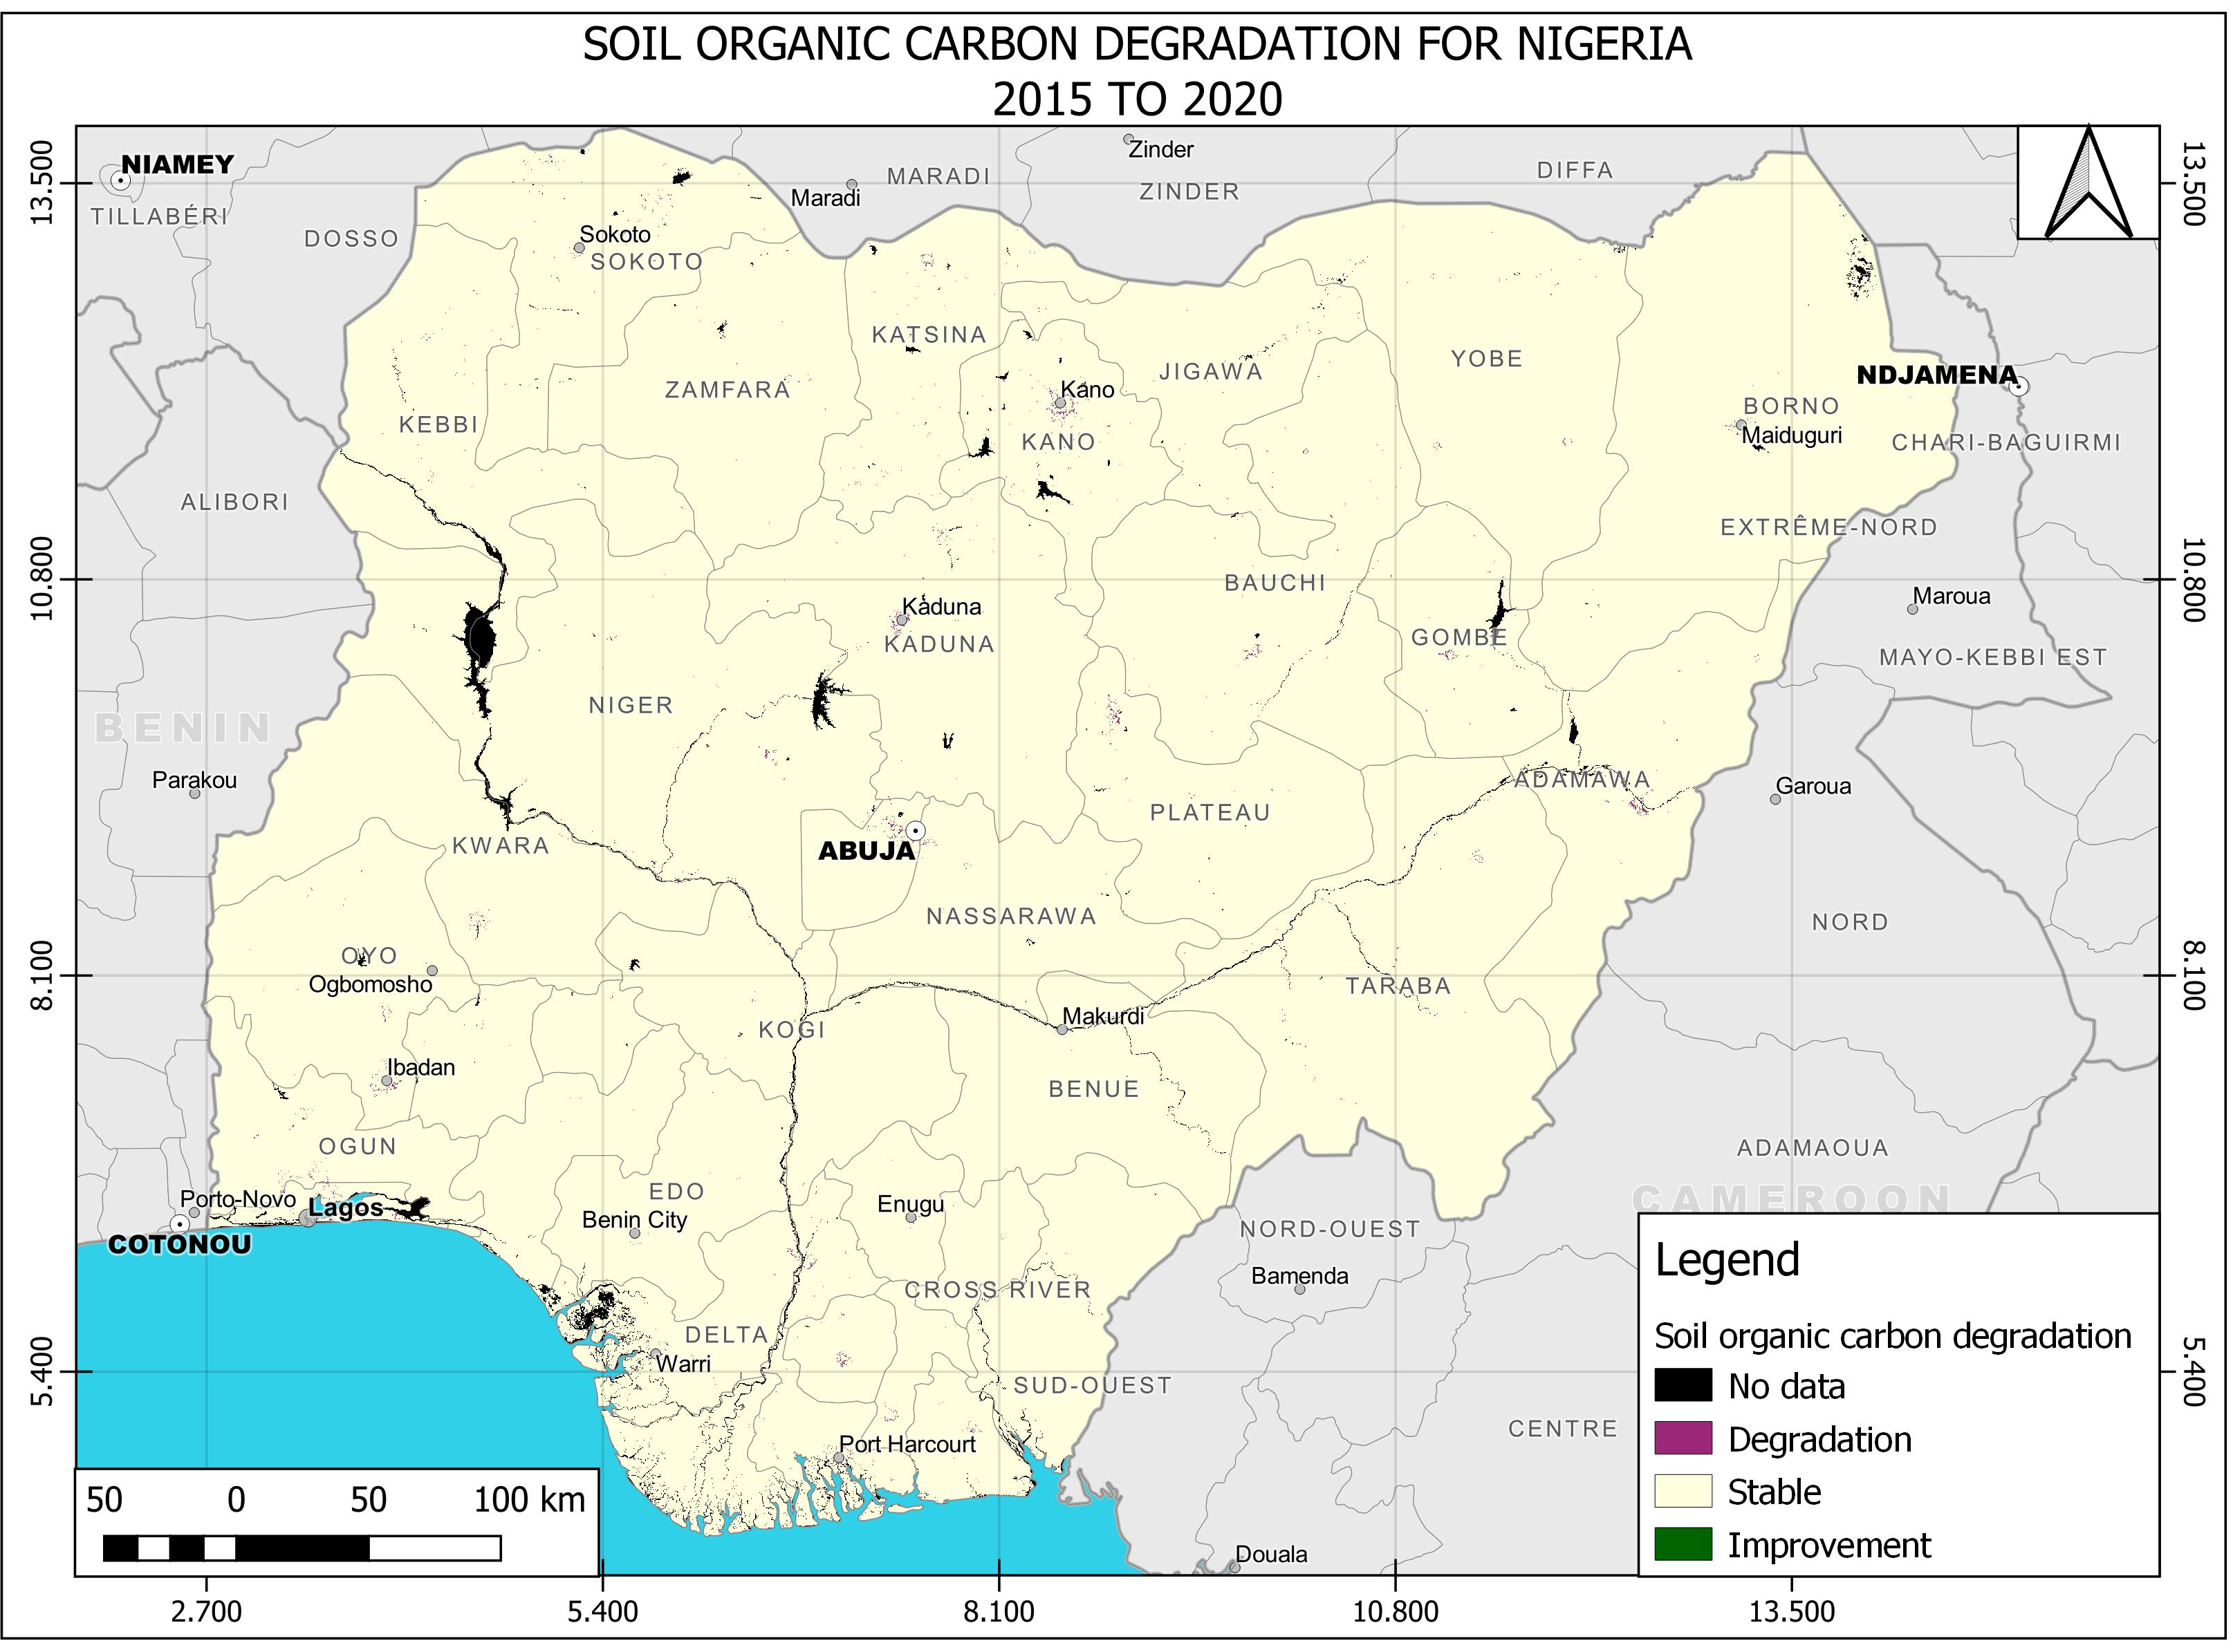
Final Results; Soil Organic Carbon Degradation

Slide 13
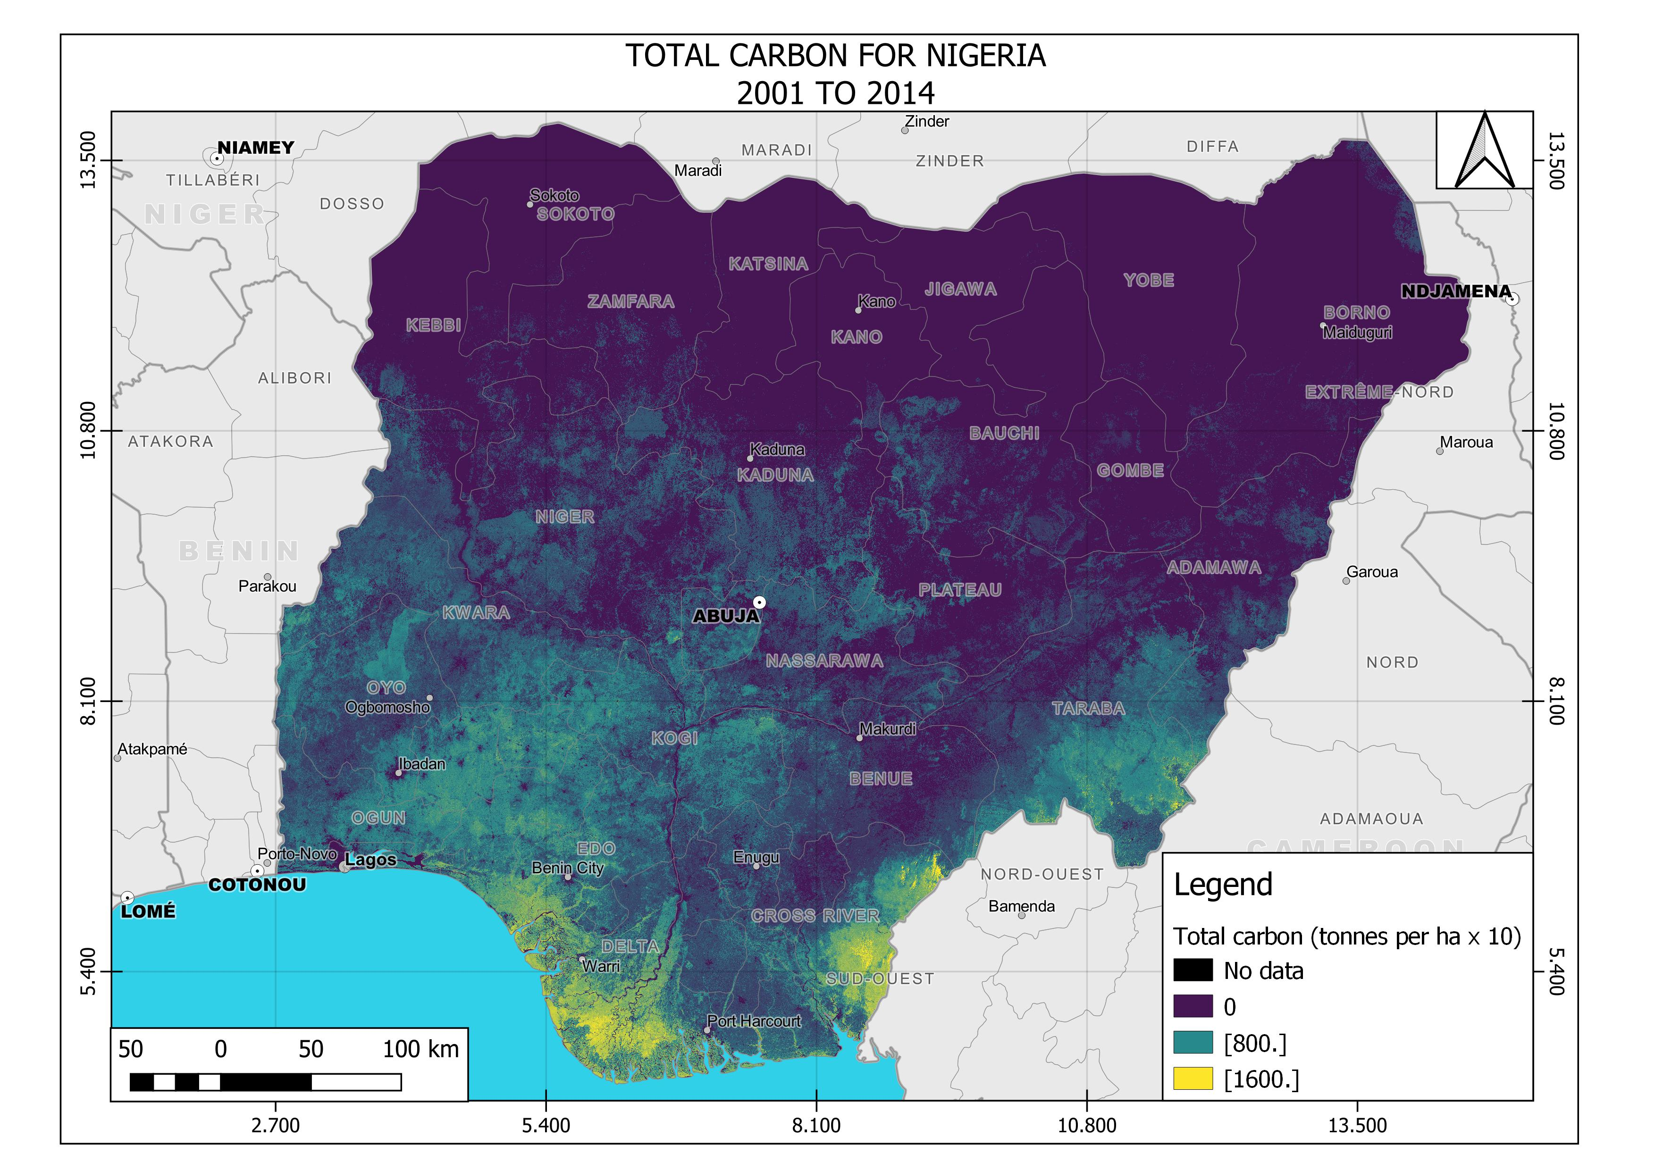
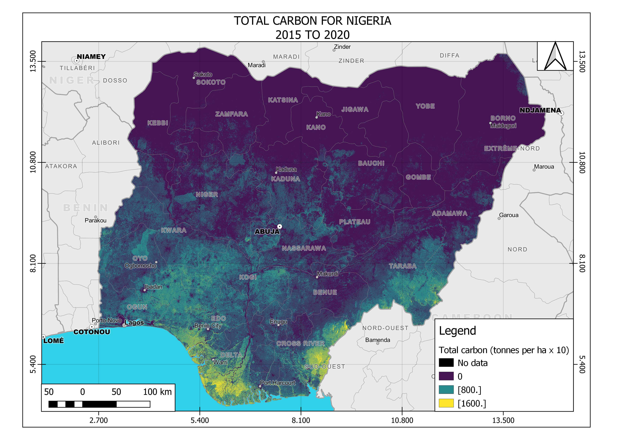
Final Results; Soil Organic Carbon

Slide 14
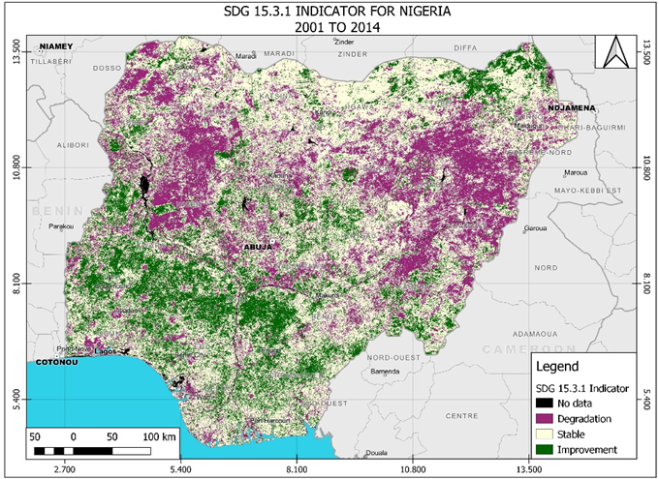
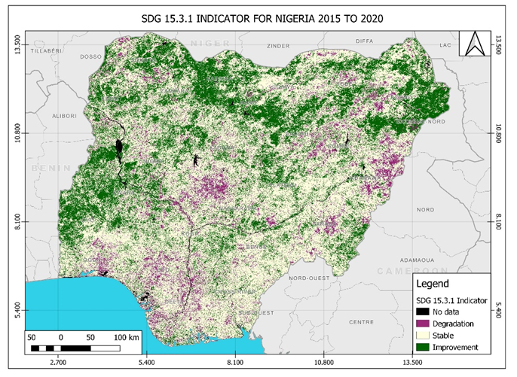
Results/Outputs

Slide 15
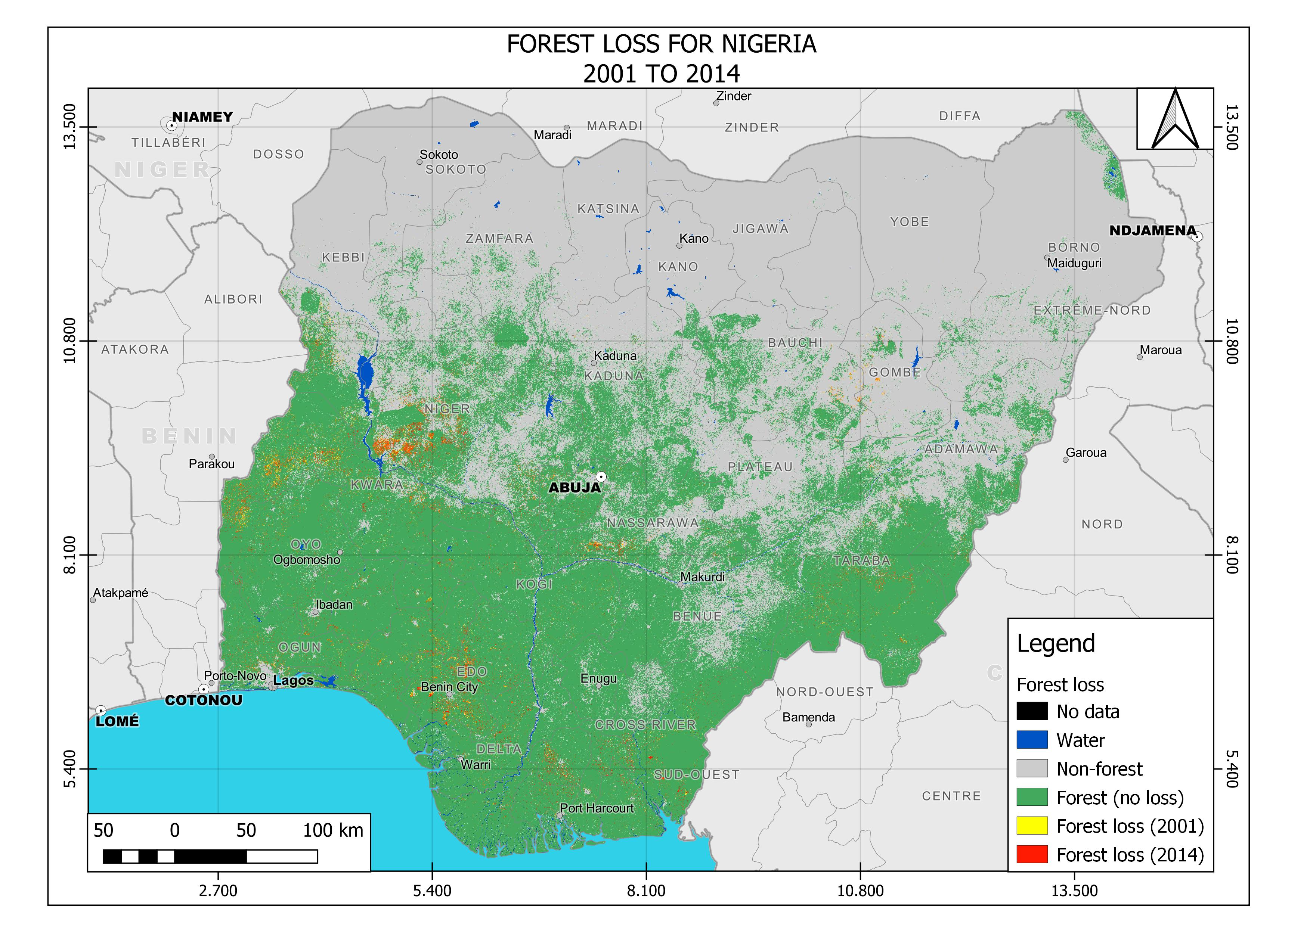
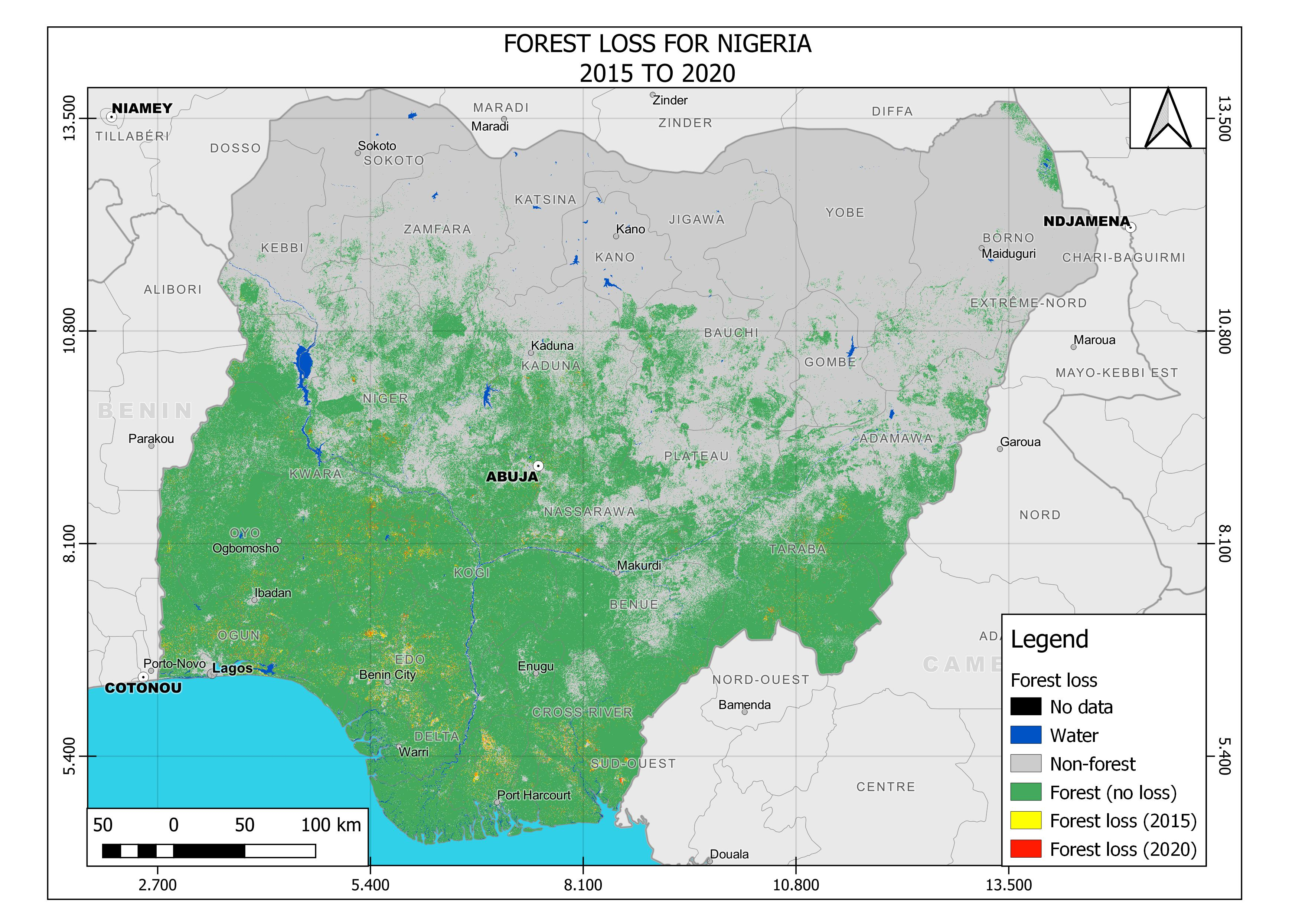
Results/Outputs
Positive Advances in LDN drive for Nigeria further advanced with the geospatial evidence of reduction in forest loss between baseline and target epochs.

Slide 16
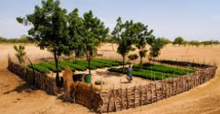
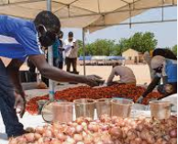
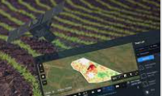
The Nigerian LDN Implementation Model
Avoid > Reduce > Reverse land degradation: Achieving and Sustaining LDN
This articulates Nigeria’s priorities and policies in planning LDN interventions and implementation:
Great Green Wall Initiative.
Multi-Sectoral, technology driven integrated land use planning policies.
Strong Institutional and Legal framework implementation
Government and Private Sector Intervention Initiatives for building-in resilience and eliminating risk factors
Continuous Monitoring and Assessment

Slide 17
Conclusion
The approaches to the assessment and monitoring of land degradation and desertification have gone beyond subjective review studies. The adapted methodology extends the Trends.Earth approach by implementing it in an Earth Observations Data Cube environment which is geospatially driven.
It has enabled a nation-wide independent comprehensive assessment of the state of the natural ecosystem and its dynamics using standardized indices. This can compliment national data sources or substitute for same in the absence of national data given its robustness and automated approach.
The underlying drivers of land degradation in Nigeria are highlighted and a comparative assessment of the critical indicators of Land cover, Land productivity and Soil organic carbon show a steady improvement and positive advance towards the attainment of Land degradation neutrality in the country.

Slide 18
Conclusion
The measures put in place to achieve and maintain LDN are effective and classed as sustainable / replicable for other nations.
The degradation state of land in the country has been on the decline or remained stable from 2015 to 2020 as shown in the results implying no net loss of the land-based natural capital relative to the reference / baseline state of 2001 – 2014 considered for current research.
This puts the country on the path to achieving the SDG Indicator 15.3.1 amounting to progress towards the attaining the UNCCD objectives

Slide 19
Expected/proposed application areas of the research
Data management, as the country does not have reliable data available at national level to define the LDN baseline and to set LDN targets.
Scientific knowledge-base to guide the countries effort to join and commit to the African Forest Landscape Restoration Initiative (AFR100).
Geospatial model for continuous, seamless and automated monitoring and assessment.
Enhancing government and Private Sector Intervention Initiatives for building-in resilience and eliminating identified LD risk factors
Knowledge base for driving Multi-Sectoral, technology driven integrated land use planning policies and guiding Institutional and Legal framework implementation.

Slide 20
Collaborators, Stakeholders and Users
Office of the President on the Sustainable Development Goals (SDG);
Ministries of Agriculture, Environment, Forestry, Mining, Transportation, Urban Development, Land Resources, Power, Works and Housing, and the National Bureau of Statistics and National Planning etc., at both State and National levels
Specific agencies and departments like the Department of Drought and Desertification, the Federal Department of Forestry, the Climate Change Agency, the Department of Erosion and Flood Control.
Universities and other research institutions involved in Land Management and Agriculture, etc.
Major International and Development partners such as UNDP, World Bank, FAO, IFAD, JICA;
The National Assembly, Security agencies, International and Local NGOs were included and leveraged for effective implementation of LDN in Nigeria
Private Sector Businesses and Investors

Slide 21
Acknowledgement
AfriGEO
RCMRD
Data Cube
TRENDS.EARTH
Author Name1: Dr. Matthew Adepoju
Co-Author¹; Chiemeka Nsofor Co-Author¹; Halima O. Idris
(1) Affiliation, Country: Department of Strategic Space Applications, National Space Research & Development Agency, NASRDA HQ, Abuja, Nigeria.
Contact email address: matthew.adepoju@nasrda.gov.ng

Slide 22
Thank you
Questions?

